Slide 1
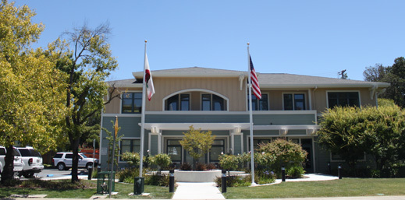
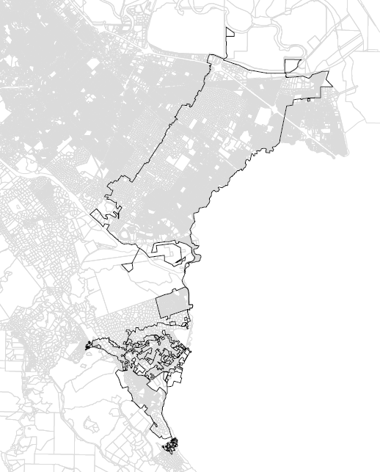
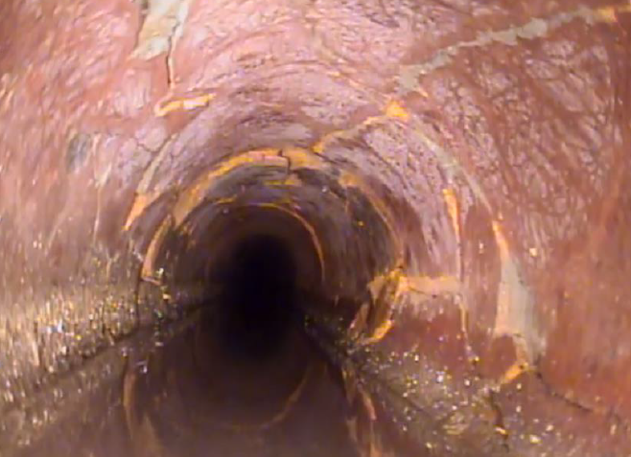
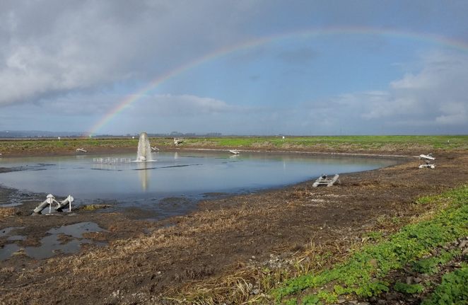
WEST BAY SANITARY DISTRICT MASTER PLAN UPDATE PRE-PROPOSAL MEETING
October 17, 2022

Slide 2
WBSD MASTER PLAN UPDATE
Master Plan Update was prepared in 2011 and updated in 2013 based on updated flow monitoring results.
WBSD intends to award contract to firm/team to prepare a Master Plan Update, 2023.
Highly recommended to follow the format shown in the RFP.
Qualified proposers will be asked to present proposal to WBSD on December 7, 2022.
Selection will be based on criteria shown in the RFP:
Quality of Proposal 30%
Proposal Presentation 45%
Resources 15%
Project Costs 10%

Slide 3
WBSD MASTER PLAN UPDATE
Last day to submit questions to District is 4:00 PST on October 31, 2022.
Submit questions to Jfeudale@westbaysanitary.org
Proposal Deadline: 3:00 PST on November 17, 2022.
One executed original, 5 copies, and one copy on flash drive of the Proposal shall be submitted.
Notifications of Proposal Presentation: November 21, 2022.
Project Award: January 2023.
Completion within 8 months of Notice to Proceed.

Slide 4
SCOPE OF WORK
Task 1: Data Collection and Assessment of Collection System
Task 2: Estimation of Flows
Task 3: Hydraulic Modeling
Task 4: System Performance Evaluation and Capacity Assurance Plan
Task 5: Capital Improvement Plan Development
Task 6: Recycled Water Planning
Task 7: Master Plan Preparation

Slide 5
SCOPE OF WORK
Chapter 1 – Introduction
Chapter 2 – Existing Wastewater System
Chapter 3 – System Flows
Chapter 4 – Hydraulic Model Development
Chapter 5 – Planning Criteria
Chapter 6 – Capacity Analysis
Chapter 7 – Pipeline Condition Assessment and Capital Improvement Projects
Chapter 8 – Pump Station Rehabilitation Program
Chapter 9 – Capital Improvement Program
Chapter 10 – Recycled Water Planning
Task 8: Project Management
Proposal shall include project management, administration, scheduling, monthly in person progress meeting attendance with District staff, and project quality assurance/quality control activities.

Slide 6
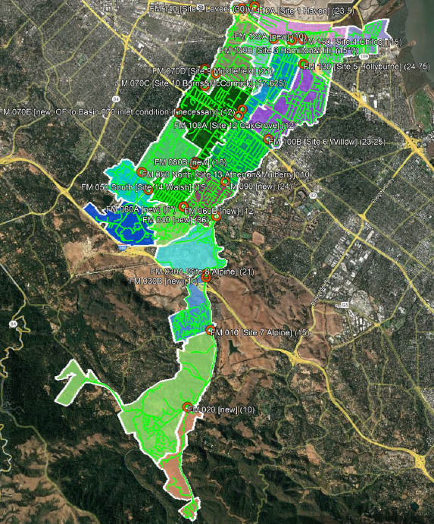
FLOW MONITORING
V&A proposes approximately 11 new flow meters to be used in conjunction with the existing 17 flow meters to isolate flow sewerage basins within the District collection system, and that also mostly conforms with the basins as already defined.
Maps of Areas will be provided.

Slide 7
Questions?

