Slide 1

WEST BAY SANITARY DISTRICT
Recycled Water Program
Site Supervisor Training
1
JUNE 2020 - DRAFT

Slide 2
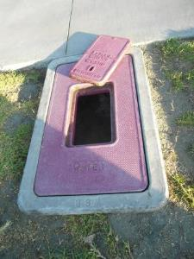
Roles and Definitions
2
Menlo Park Municipal Water District
  - Potable water distributor (domestic and fire suppression)
West Bay Sanitary District
  - Wastewater collections and treatment
  - Recycled water producer and distributor
Customer
  - Site utilizing recycled water through agreement with WBSD
Site Supervisor
  - Responsible for the use of recycled water on the customer site

Slide 3
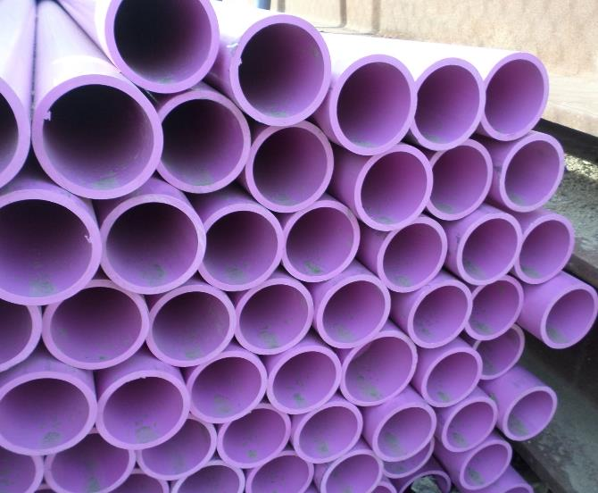
Presentation Overview
3
Water Supply
Overview
Recycled Water:
Benefits | Quality | Uses
Regulatory
Requirements
Potable Water
Supply Protection
Cross Connection
Test Procedures
Site Supervisor
Responsibilities

Slide 4
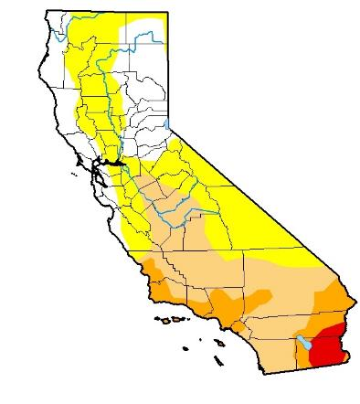
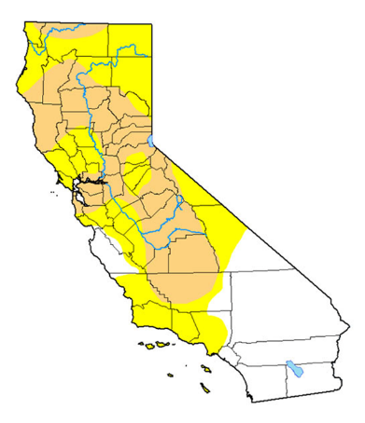
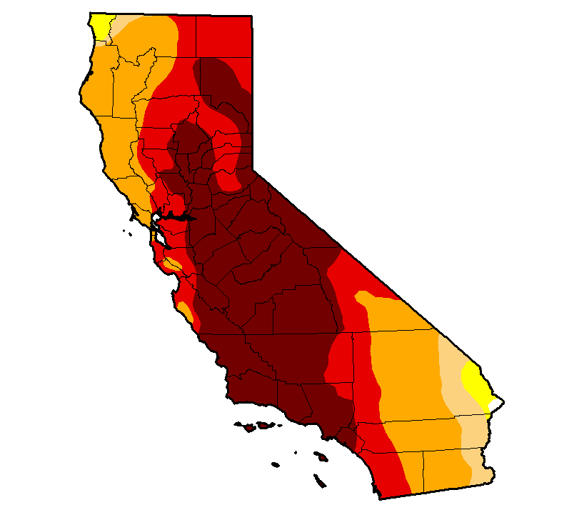
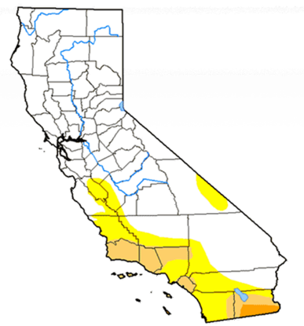
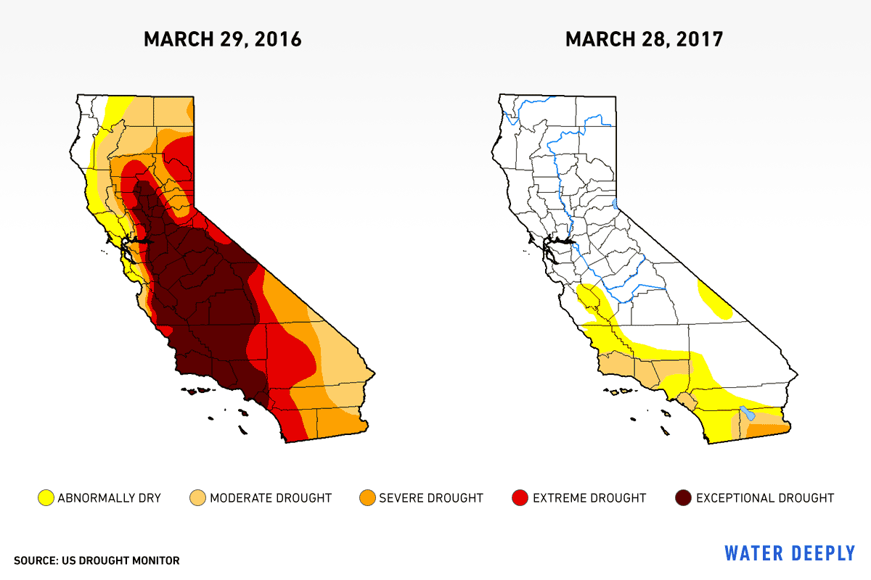
As Californians, we live in a constant drought and need to conserve water
4
March 2015
March 2017
March 2018
March 2020
2016
Wet Year
2019
Wet Year

Slide 5
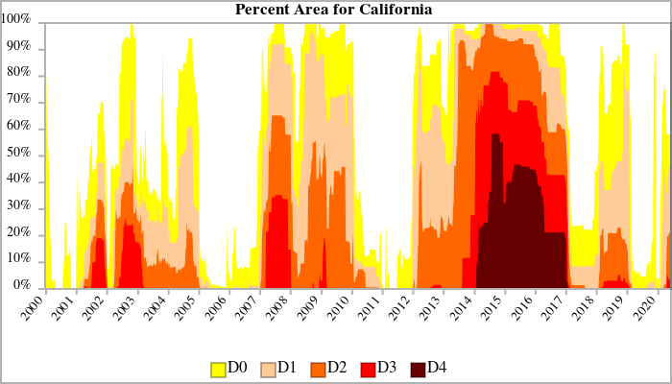
As Californians, we live in a constant drought and need to conserve water
5

Slide 6
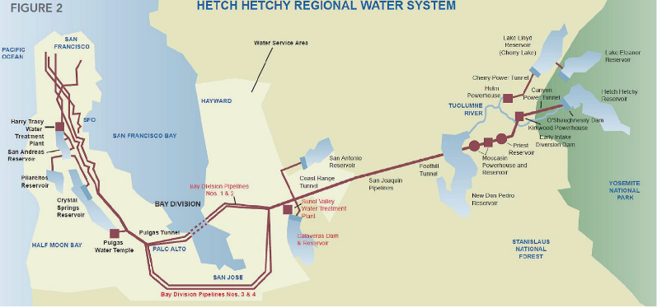
Menlo Park’s Water Supplies
6
San Francisco Regional Water System
  - Hetch Hetchy
  - Surface Water suppl.
Recycled Water

Slide 7
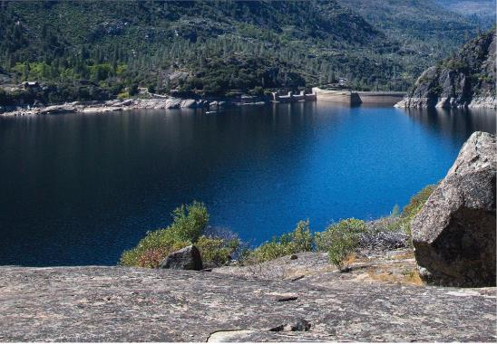
Benefits of Using Recycled Water
7
Conserves water that would otherwise be used for non-potable irrigation
Provides a reliable and drought-proof water supply source; potential cost savings
Higher nutrient content of recycled water benefits landscaping by reducing the need for chemical fertilizers
Aids in compliance with the Federal Clean Water Act by reducing discharge of treated sewage into rivers/oceans/bays

Slide 8

Introduction to Recycled Water
8

Slide 9
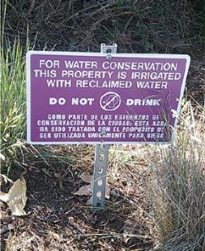
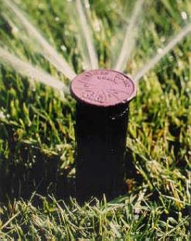
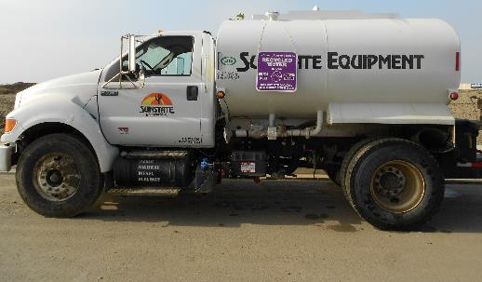
9
What is Recycled Water?
Recycled water is highly treated municipal wastewater that can be used for non-potable applications
  such as landscape irrigation, street sweeping, construction water
  (dust control, soil compaction)
Recycled Water is NOT graywater, stormwater, or rainwater

Slide 10
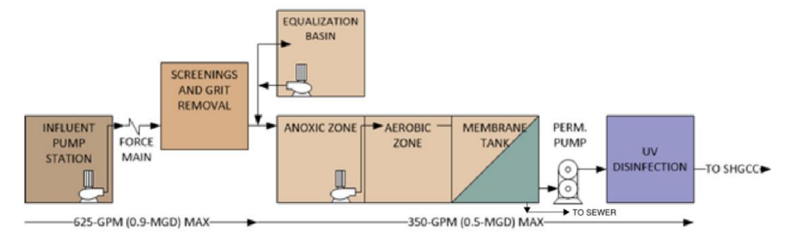
How is Recycled Water Produced?
10
Screening
Membrane Bioreactor
UV Disinfection
Wastewater Influent
Recycled Water Effluent
Notes:
WBSD’s recycled water is treated at the 0.9 MGD max Water Reclamation Facility (WRF) to a tertiary level (three levels of treatment, including filtration and disinfection).

Slide 11
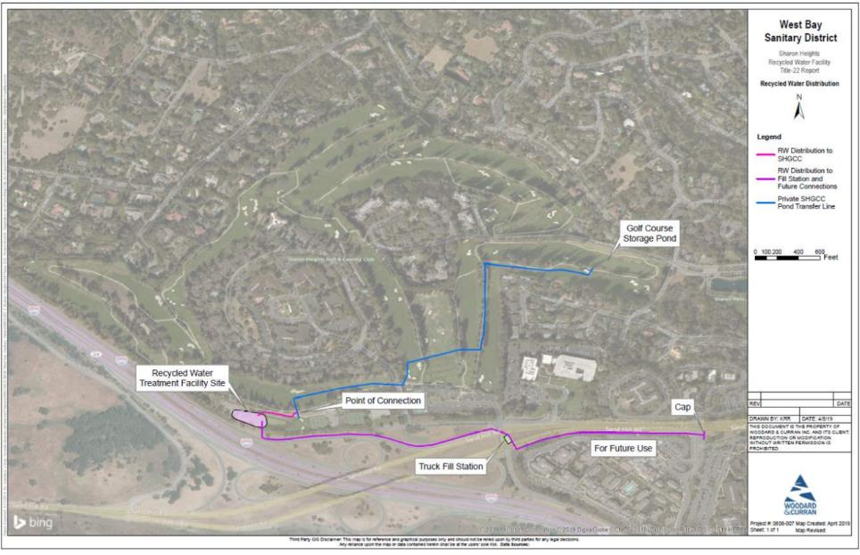
Recycled Water System Map
11
Notes:
GC is not only customer

Slide 12
Water Quality Comparison
12

Slide 13
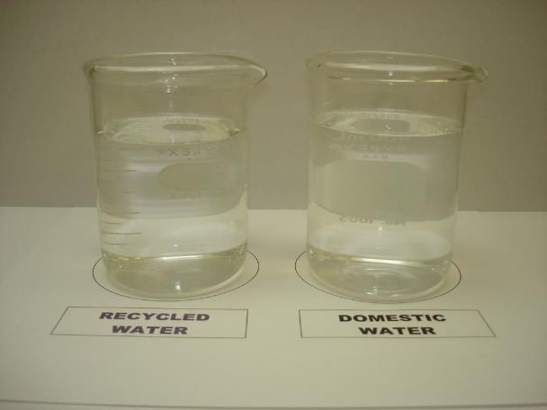
Recycled Water vs Drinking Water
13

Slide 14
Water Quality Comparison
14
Update with WQ info?
 | California Drinking Water Standards (MCL) | Recycled Water ^{( A )} |  |  | Potable Water ^{( B )} | Potable Water ^{( B )}
 |  | WBSD WRF |  |  | Hetch Hetchy | Hetch Hetchy
SUBSTANCE (UNIT OF MEASURE) |  | Min - Max |  | Average | Min - Max | Min - Max | Average
Chloride (ppm) | 500 |  |  |  | 3 to 17 | 3 to 17 | 8.9
BOD | -- |  |  | 10
Ammonia, NH3-N | -- | < 5 |  | 1
pH (Units) | 7.5 | 7 to 9 |  |  | 8.6 to 9.8 | 8.6 to 9.8 | 9.4
Sulfate (ppm) | 500
Total Dissolved Solids (ppm) | 1,000 |  |  | 610 | 20 to 144 | 20 to 144 | 82
Turbity (NTU) | 5 |  |  |  | ND to 0.63 | ND to 0.63 | 0.1
Total Nitrogen (mg/L) | --
ND = Not Detectable
^{A} Per WBSD SHCC T22 ^{B} Per Menlo Park June 2019 Water Quality Report

Slide 15
Suitable Uses
15

Slide 16
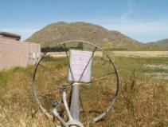
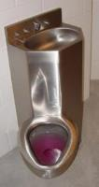
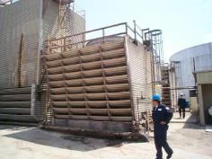
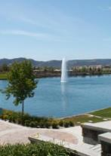
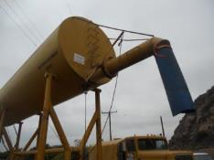
16
Allowable Use is Determined
by Recycled Water Quality
Allowed by the State for disinfected tertiary effluent:
Agricultural irrigation:
  Growing of field and nursery crops, row crops, tree, and vines; and the feeding of fowl and livestock
Landscape irrigation:
  Parks, golf courses, cemeteries, freeways, open spaces, landscaping
Commercial use:
    Toilet flushing, floor trap priming
Industrial use:
    Cooling towers, process water, etc
Recreational impoundments
Construction water
Groundwater recharge
Notes:
16

Slide 17
Is Recycled Water Safe? YES
17
No health-related problems have been traced to any recycled water project operating in California.
Standards for recycled water are among the strictest in the world.
Carefully monitored by local water quality control agencies and health authorities.
Recycled water treatment does not eliminate every organism. Should not be used for drinking or other human consumption uses, such as hand-washing
or bathing.

Slide 18
Regulatory Requirements
18
Notes:
WBSD’s Recycled Water Rules & Regulations
Follows guidelines outline in California Code of Regulations Title 17 and Title 22
California Plumbing Code: domestic piping dual plumbed systems (Ch. 15)

Slide 19
WBSD’s Recycled Water
Rules & Regulations
19
Preliminary Approvals
Onsite Retrofit Improvements
Final Approvals and Connection
Customer agreements
Site Plans
Approvals:
WBSD, DDW, MPMWD
Cross connection testing
Onsite improvements
Irrigation System & Coverage inspections
Site supervisor training
Final approval
Connect to RW meter
Ongoing Monitoring & Record Keeping

Slide 20
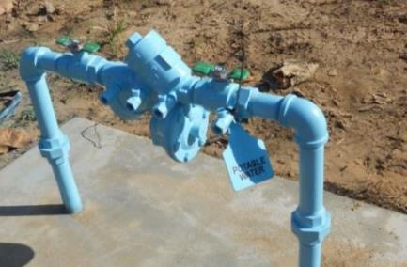
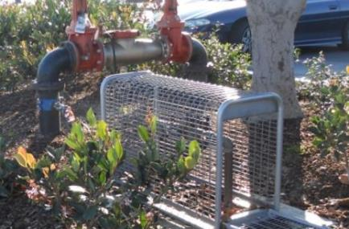
California Code of Regulations – Title 17
20
Defines Responsibilities for Protection of Public Water Systems
Requires Site Supervisors
Identifies Location and Type of Backflow Protection based on degree of risk
  Air-Gap
  Reduced Pressure Principle Assembly(RPBA)
  Double Check Valve Assembly (DC)

Slide 21
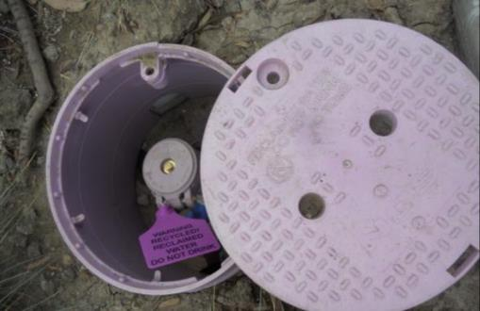
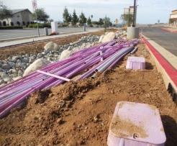
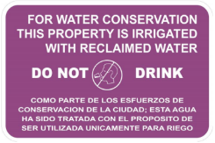
California Code of Regulations – Title 22
21
Identifies Treatment and Effluent Quality Requirements
Defines Allowable Uses
Includes Use Area Requirements
        Runoff limitations
        Overspray
        Signage
      Reporting and Record Keeping
Design Requirements
Inspection and Cross-Connection Testing

Slide 22
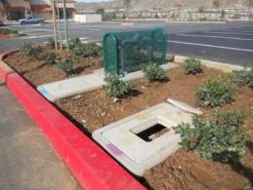
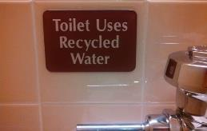
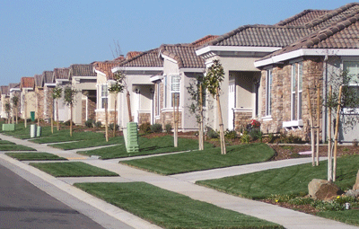
Dual Plumbing vs. Dual Source sites
22
“Dual Source” is a site where both potable and recycled water are used, but the definition of dual plumbed is not met (i.e., irrigation at a school/park or commercial bldg.)
“Dual Plumbed” means a system that uses separate piping within a facility, where recycled water is used:
  To serve plumbing outlets (toilets) within a building
  For outdoor landscape irrigation at individual residences

Slide 23
Potable Water Supply Protection
23

Slide 24
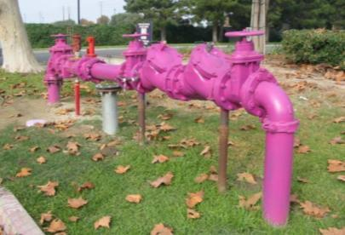
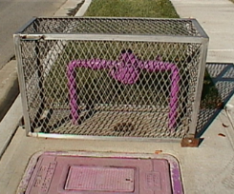
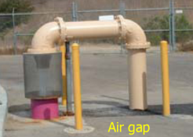
24
Backflow Devices
Types (Title 17 defines)
  Air Gap Separation
  Reduced Pressure Principle
  Backflow Assembly (RPBA)
  Double Check Valve Assembly (DC)
Notes:
24
There are five acceptable means of protecting against backflow.
The air gap, the reduced pressure principle assembly (RP) the double check valve assembly (DC), the pressure vacuum breaker (PVB) which would also include the spill-resistant vacuum breaker (SVB) and the atmospheric vacuum breaker (AVB). It is important to match the assembly being used to the hydraulic condition of the cross-connection and the degree of hazard.

Slide 25
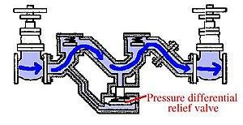

Backflow Device Design Features
25
Air Gap Separation
Reduced Pressure Principle Assembly (RPBA)
Double Check Valve Assembly
Potable water
2x pipe Ø ≥ 1” min.
To RW system

Slide 26
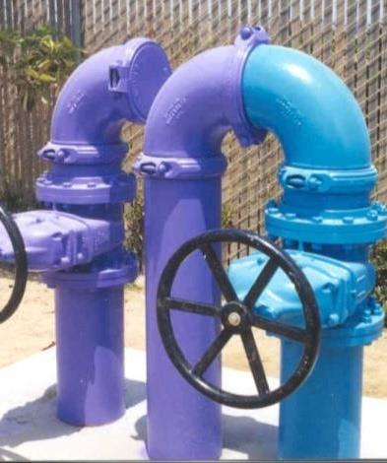
26
Swivel Ells
Provides potable water backup supply in the event that recycled water is not available in an emergency
Cannot be used for more than 90 days
Potable supply must have an RPBA
Potable water purveyor must notify DDW
within 24 hours of switchover

Slide 27
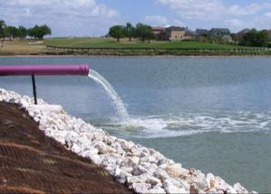

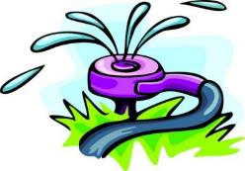
Well Protection
27
  No impoundment of recycled water within 100 feet of domestic well
  No irrigation of recycled water within 50 feet of domestic well unless specific site conditions are met (Title 22)
100 feet min
50 feet min
Notes:
Geological investigation of aquitard; annular seal; prevent spray from well head; drain away; elimination of buffer by owner of well

Slide 28
On-Site System Design Features
Pipe Separation
28

Slide 29
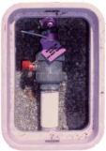

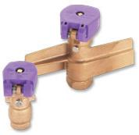
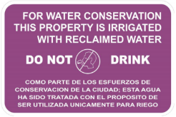
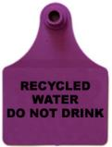

29
Onsite Recycled Water System Identification
The recycled water system must be clearly distinguished from the potable water system.
Use Purple pipe and RW ID fixtures.
Tag all valves. Maintain RW signage.
No hose bibs are allowed on the RW system
(in public access areas)
Quick Coupling Valves
Notes:
Mention some agencies use ACME thread only for RW QCVs

Slide 30
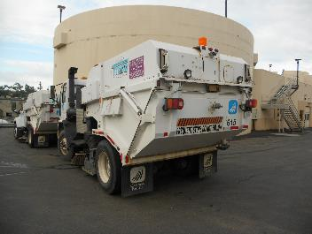
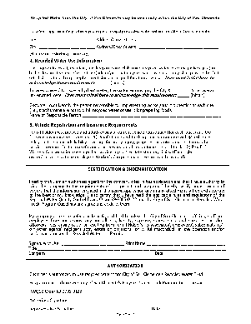
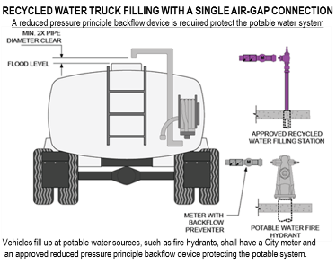
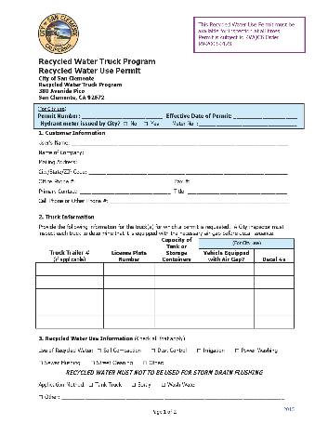
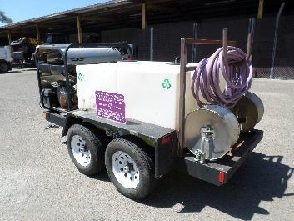
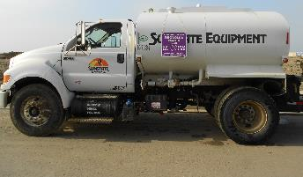
Recycled Water Identification
Construction Uses
30
Notes:
ID but more importantly, training and tracking usage

Slide 31
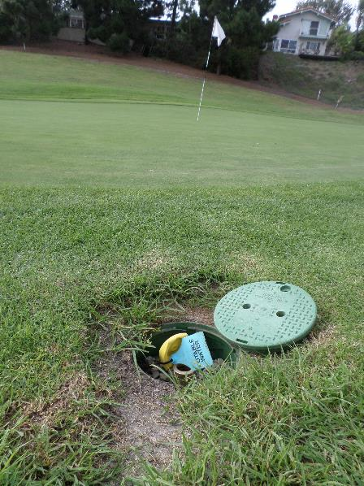
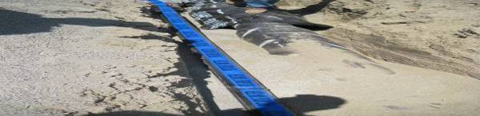
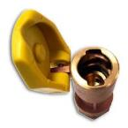
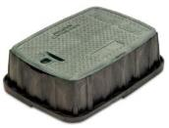



Onsite Potable Water System Identification & BMPs
31

Slide 32
Cross Connection Testing
32

Slide 33

33
What are cross-connections?
A cross-connection is any unprotected connection between a public or consumer’s drinking water supply and other sources of water, such as agricultural, raw and recycled water. Cross-connections are strictly prohibited.
Cross-connection tests are required for sites that include both potable and recycled water

Slide 34


34
Cross Connection Test Preparation
Approved accurate plans/as-builts
Customer notification for potable water testing
Points of connection for potable and
recycled water lines
Elevation considerations for draining system
Equipment that uses water is secured during the test
Participation by local water purveyor and customer’s Site Supervisor to run irrigation systems during test

Slide 35


35
Two-Way Shutdown Test Method
Establish Baseline: operate potable and recycled water uses
Potable Water Off: shutoff the potable feed at the point of connection (usually the meter)
    Operate recycled water to verify pressure
    Operate potable uses to verify no pressure.
Recycled Water Off: shutoff the recycled water system feed
    Operate domestic water uses to verify pressure
    Operate irrigation uses to verify no pressure

Slide 36






Other Cross Connection Test Methods
36
Pressure Test
  Depressurize system to 30 to 50 percent
Dye Test
  Avoids shutting down potable
TDS Test
  Avoids shutting down potable
Visual Inspections

Slide 37
Site Supervisor Responsibilities
37

Slide 38

Site Supervisor Responsibilities
38
The Recycled Water Site Supervisor is responsible for:
Overseeing the O&M of the on-site water systems
Ensuring that there are no cross-connections
Acting as a liaison to WBSD
Completing periodic inspections with WBSD
Answering questions and training personnel
Maintaining system records
Performing repairs and preventative maintenance on the system to ensure it remains in compliance with all WBSD and State requirements
Notes:
Might be good before operation slide, remove Self Inspection Report?

Slide 39

Recycled Water System Operations
39
Operation of landscape irrigation systems can occur:
    Between 9 p.m. – 7 a.m. for automatically controlled systems to minimize wind drift and public contact
    During the day if monitored and controlled as required to prevent public exposure

Slide 40


Recycled Water System Operations
40
Rules to follow for the proper application of
recycled water:
  Don’t allow recycled water to contact
  drinking fountains, picnic tables or eating areas
  Don’t allow recycled water to pond or puddle
  Don’t allow recycled water to runoff the site or area
  by either over-spraying or overwatering
  Don’t use recycled water on an unapproved site
  or other area

Slide 41


Recycled Water System Maintenance
41
Self inspection of the system components
  Includes sprinkler heads/nozzles, piping and valves, pumps, storage facilities, controllers, etc.
  Any broken or non-functioning components must be repaired immediately
    In the event that a system break does occur, the Site Supervisor must:
  Immediately turn off the system once the break is detected
  Immediately contact the WBSD
  Discharge of 50,000 gallons or more, WBSD must notify RWQCB

Slide 42


42
Recycled Water System Maintenance
Check all recycled water site and system identification
  This includes signs, tags, stickers and above ground pipe markings for their proper placement and legibility
  Replace damaged, unreadable or missing signs, tags, stickers and pipe markings

Slide 43


43
Recycled Water System Maintenance
Check irrigation spray patterns for ponding, runoff and wind-blown spray conditions
    If evidence of ponding or runoff is noted, sprinkler heads should be adjusted to prevent further ponding or runoff

Slide 44


44
Recycled Water System Maintenance
Ensure that no cross connections exist between the potable and recycled water systems
Establish and maintain an accurate record keeping system of all inspections, modifications and repair work

Slide 45

Recycled Water System Maintenance
45
Complete Inspection Form Annually
Notify the WBSD in the event of a break in the system, low pressure,
low flow, poor water quality, or any other damage or change in the condition of the system

Slide 46
Personnel Training
46
The Site Supervisor is responsible for training all personnel involved with recycled water so they are familiar with all applicable rules and regulations.
At a minimum, the training by the Site Supervisor should convey the following information:
  Tertiary treated recycled water, although highly treated, is non-potable and must never be used for human consumption.
  Regulations prohibit ponding, overspray and runoff of water from irrigation sites.
  Working with non-potable recycled water is safe if common sense is used and appropriate regulations are followed.
  Cross-connection between the recycled water system and potable water system is strictly prohibited by State law.
  The Site Supervisor oversees the use of recycled water on-site and is the liaison with the WBSD.

Slide 47
Emergency Procedures:
Cross Connection
47
Cross connections between the recycled water system and the potable water system are prohibited. In the event of a cross connection, the following steps must be taken:
Immediately shut down the recycled water supply to the facility. Keep the potable system pressurized and post "Not for Drinking" signs at all potable water fixtures and outlets.
Notify WBSD by telephone immediately. This notification must be followed by a written notice within 24 hours that includes an explanation of the nature of the cross-connection, date and time discovered, and the contact information of the person reporting the cross-connection.
Provide bottled water until the potable water system is deemed safe to drink by MPMWD.
After final approval has been obtained from the State DDW, the WBSD will bring the recycled water system back into service and inform the Site Supervisor to remove the "Do Not Drink" signs.
Notes:
add phone #

Slide 48
Contact Information
48
WBSD to provide info
Party | Responsibility | Title | Phone Number
West Bay San District | Questions, procedures, and emergencies |  | (650) 321-0384
Menlo Park Water District | Water purveyor
California Division of Drinking Water (DDW) | Public health and regulatory oversight |  | (510) 620-3474
Regional Water Quality Control Board | Permitting and regulatory oversight
County Environmental Health | Public health

Slide 49
Site Supervisor Do’s & Don’ts
49

Slide 50
50
Water Recycling DO’s…
  do install / maintain signs at all points of entry
  do install / maintain labels/ tags on all water systems (RW, PW)
  do manage public access to the site to avoid public contact with recycled water
  do operate landscape irrigation only between 9pm - 7am
  do contact the WBSD with all water system modifications (RW, PW)
  do educate / train onsite personnel on safe use and restrictions
  do maintain accurate site records and as-built drawings
  do conduct inspections and adjust irrigation rates to avoid runoff and ponding
  do cooperate with the WBSD and assist with periodic inspections
  do contact WBSD immediately with any line break, cross connection,
  or violation of water recycling requirements

Slide 51
51
Water Recycling DON’Ts…
  don’t drink recycled water
  don’t wash body parts with recycled water
  don’t remove identification tags, labels, etc.
  don’t spray RW onto drinking fountains or eating areas
  don’t allow ponding or runoff of recycled water
  don’t irrigate when it is raining or when the ground is saturated
  don’t spray irrigate when wind speed exceeds 30 mph
  don’t allow public access to hose bibbs or unlocked valves
  don’t use for unapproved applications
  don’t use same equipment (e.g. hoses) for both RW and PW
  don’t make significant modifications to either RW or PW systems without WBSD approval
  don’t CROSS-CONNECT POTABLE WATER AND RECYCLED WATER!!!

Slide 52
Questions?
52
Woodard & Curran
Kraig J. Erickson, P.E.
kerickson@woodardcurran.com
(949) 420-5306

